Slide 1

PROACTIVE DISASTER MANAGEMENT FOR FIRE HAZARDS

Slide 2
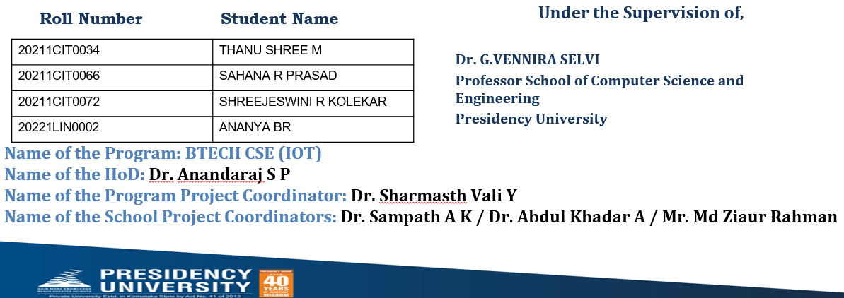
PIP2001 Capstone Project
Review-0
Batch Number:CIT-G31

Slide 3
Introduction
Fire incident is a disaster that can potentially cause the loss of life, property damage and permanent disability to the affected victim.
Major fire accidents do occur in industries like nuclear power plants, petroleum refineries, gas tanks, chemical factories and other large-scale fire industries resulting in quite serious consequences
With the advancement in the field of Robotics,IOT, human intervention firefighting robot comes in picture.

Slide 4
Literature Review
Title of the Paper
Fire extinguishing robot
Development of Fire Fighting Robot (QRob)
Automatic Fire Extinguisher Robot Using IoT
Automatic Fire Fighting Robot
SOUND FIRE EXTINGUISHER ROBOT CONTROLLED BY SPEECH
AUTOMATIC IC FIRE EXTINGUISHER ROBOT
Development and Implementation of Arduino microcontroller-based Dual Mode Fire Extinguishing Robot
Autonomous Fire Detecting and Extinguishing Robot Hazards
FIRE FIGHTING ROBOT using IOT
An Analytical Study of Various Methods Used Autonomous FireExtinguishing RoboT

Slide 5
Existing method Drawback
Ensuring the robot is reliable and safeIntegrating it with existing fire safety systems, and managing the data and connectivity required for IoT functionality
By making it GPS enabled
Remotely controlled and live video buffering
More latency
Not reliable

Slide 6
Proposed Method
This proposed system for a fire extinguisher robot with IoT-enabled notification alerts aims to enhance fire safety through automation and remote monitoring.
The Blynk app facilitates user interaction, providing real-time data and control, making it a valuable addition to smart home or industrial safety solutions.

Slide 7
Objectives
Autonomous Fire Detection
Automated Fire Suppression
Real-Time Notifications
User Control and Monitoring
Obstacle Navigation
Data Logging and Analysis
User-Friendly Interface
Integration with Smart Home Systems
Reliability and Safety
Cost-Effective Implementation

Slide 8
Methodology/Modules
Sensor Module
Control Module
Navigation Module:Pathfinding Algorithm
Extinguishing Mechanism Module:Actuator Control, Fluid Delivery System
Communication Module:(ESP32) ,Blynk API Integration
User Interface Module:Blynk App Configuration, Notification System
Power Management Module:Batteries
Maintenance Module

Slide 9
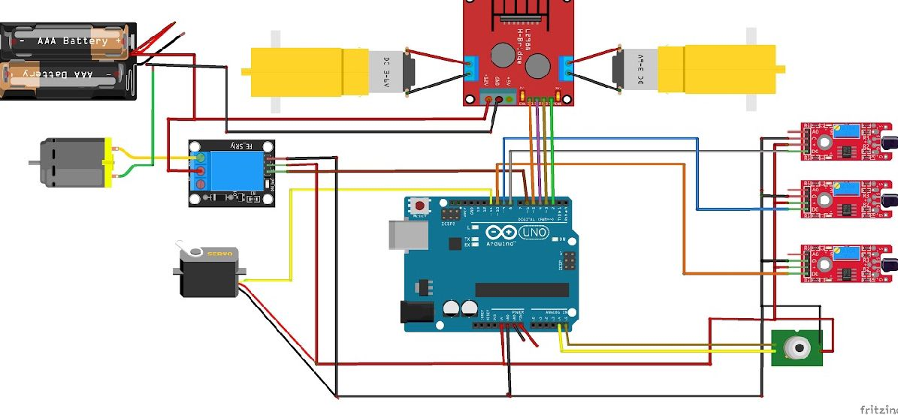
Architecture

Slide 10
Hardware/software components
Sensor Module
Temperature Sensors- DHT11
Smoke Sensors MQ-7 ,Flame Sensor
Ultrasonic Sensors: Measure distance and avoid obstacles during navigation.
Control Module
Microcontroller: Arduino UNO R3
Motor Driver: L298 Driver,BO motor
5V relay module,mini Breadboard,MLX90614

Slide 11


Software components
The Arduino IDE is an open-source software, which is used to write and upload code to the Arduino boards.
Blynk is a oT software platform for connecting devices to the cloud, building mobile apps to remotely control and monitor them, and managing

Slide 12
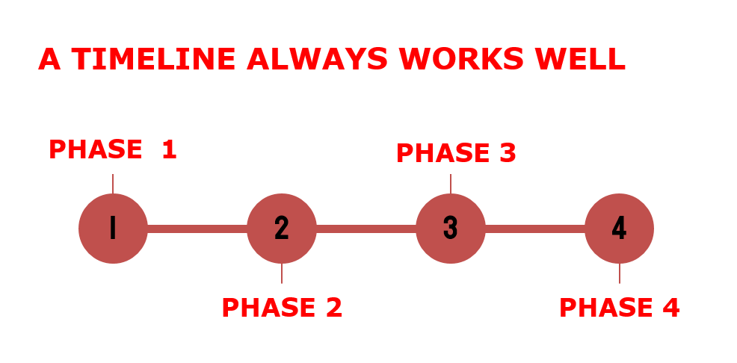
Timeline of Project

Slide 13
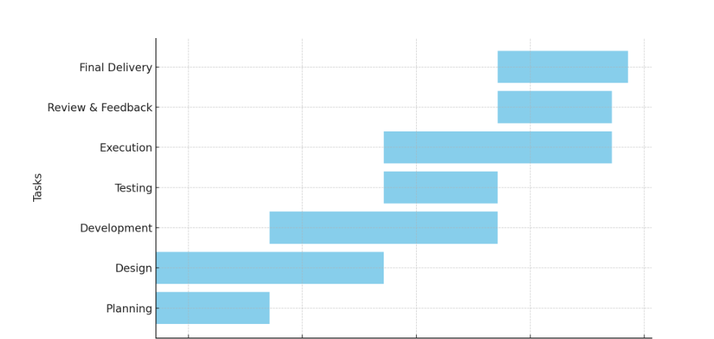
TIMELINE

Slide 14
Expected Outcomes
The fire extinguisher robot with IoT-enabled notification alerts using the Blynk app is expected to significantly enhance fire safety by providing timely detection and autonomous suppression of fires.
Real-time monitoring with quick response,highly secured,safety and awareness, through the Blynk app empowers users with valuable insights into environmental conditions .

Slide 15
Conclusion
This innovative solution promises to create safer living and working environments by proactively addressing fire risks and enhancing emergency response capabilities.
Ability to navigate and deploy extinguishing agents autonomously minimizes the need for human intervention in hazardous situations.

Slide 16
Github Link
The Github link provided should have public access permission.
Github Link
https://github.com/Sahana20211cit0066/Capstone_Project_CITG-31_PROACTIVE-DISASTER-MANAGEMENT-FOR-FIRE-HAZARD-

Slide 17
References

Slide 18

Project work mapping with SDG

Slide 19
Thank You

